Slide 1
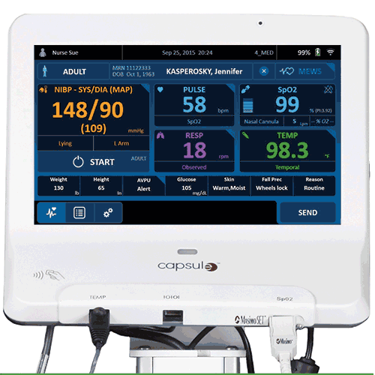
IncubateIND Presentation
Patient Monitoring System
Presented by:
Alan Antony
Aaron George Michael
“The Misfits”

Slide 2
CONTENTS
Introduction
Block diagram
Components
How it works
Algorithm
Tools Used
Advantages
Ergonomics
References

Slide 3
INTRODUCTION
Measures Patient's Vital statistics
Checks whether Values are satisfactory
Sends alert when patient is in need
Continously monitored
Statistics can be viewed in real-time

Slide 4
INTRODUCTION
Brings immediate attention to patient
Reduced need for staff monitoring
Built to be portable
Should fit all patients
Placed on a stand or wall-mounted

Slide 5
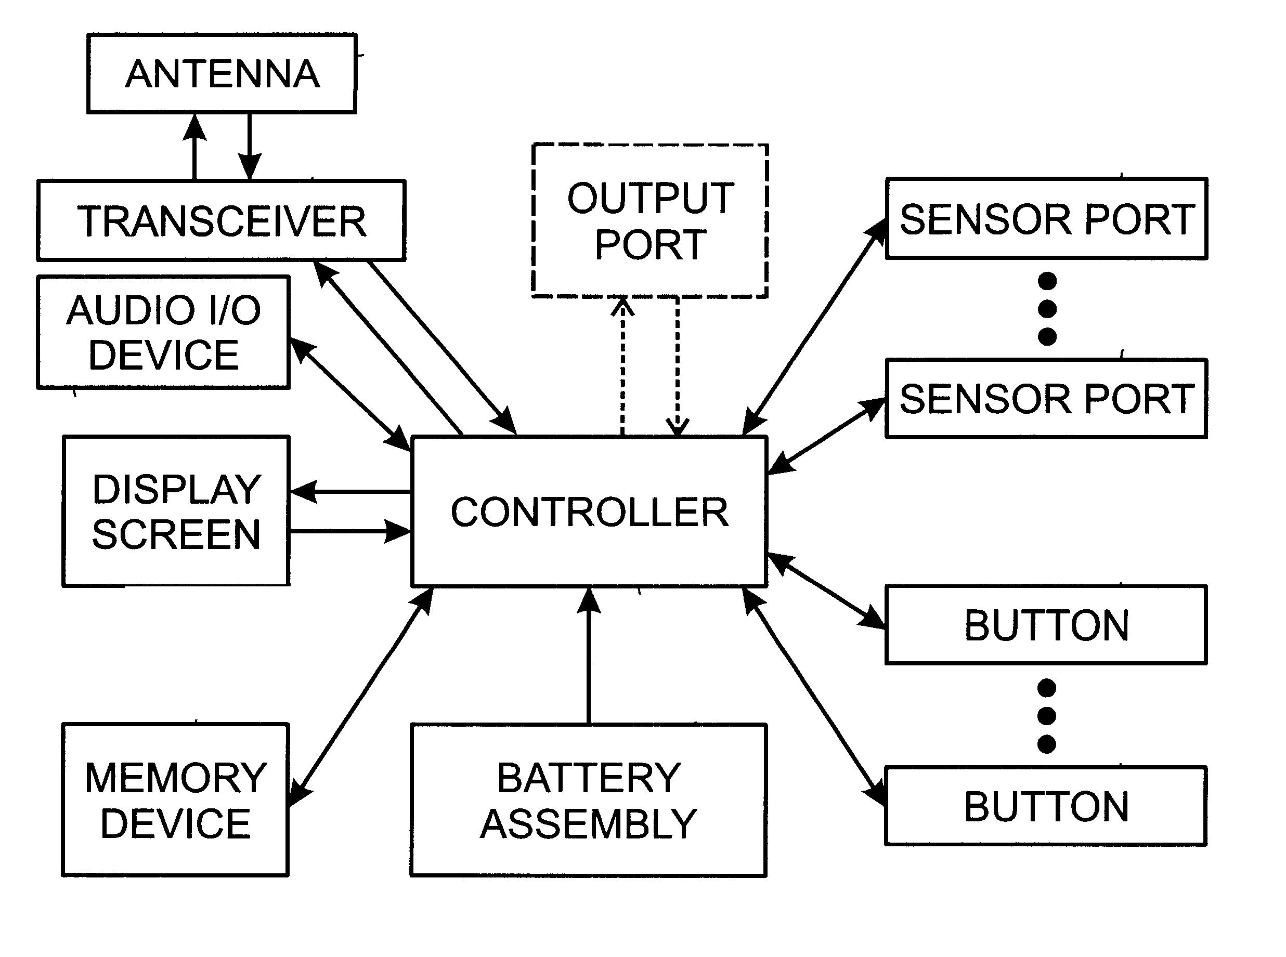
BLOCK DIAGRAM
Fig 1. Block Diagram of Monitoring System Ref[2]

Slide 6
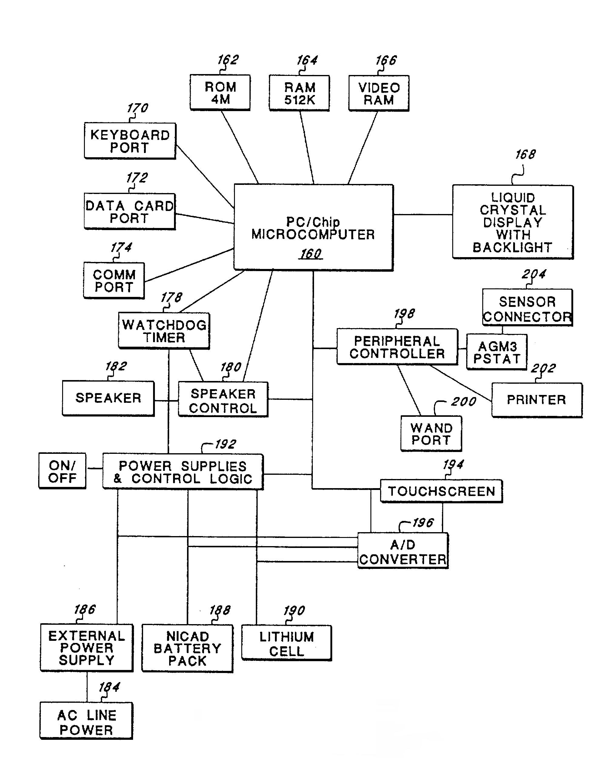
COMPONENTS
Fig 3. All Components of the system Ref[1]

Slide 7
WHAT IS IT?
A Raspberry Pi Based Product
The Pi Reads sensor inputs and monitors them to check for inconsistencies.
If any Parameter needs attention, alarm is thrown and the required staff is contacted on their handheld Device

Slide 8
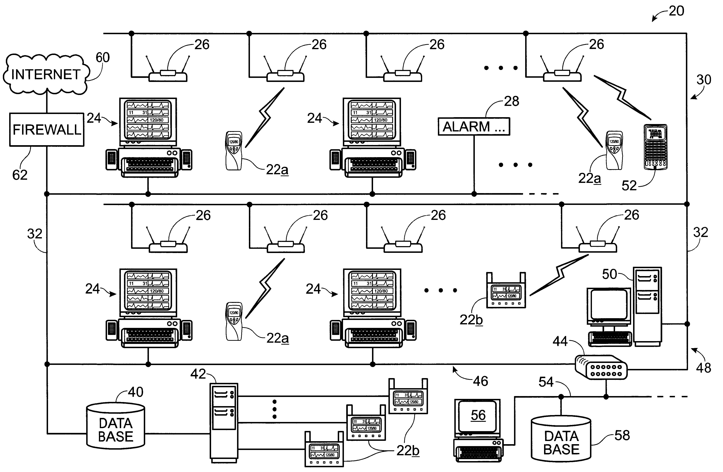
HOW IT WORKS
Fig 4. Network Connections of Multiple Systems Ref[2]

Slide 9
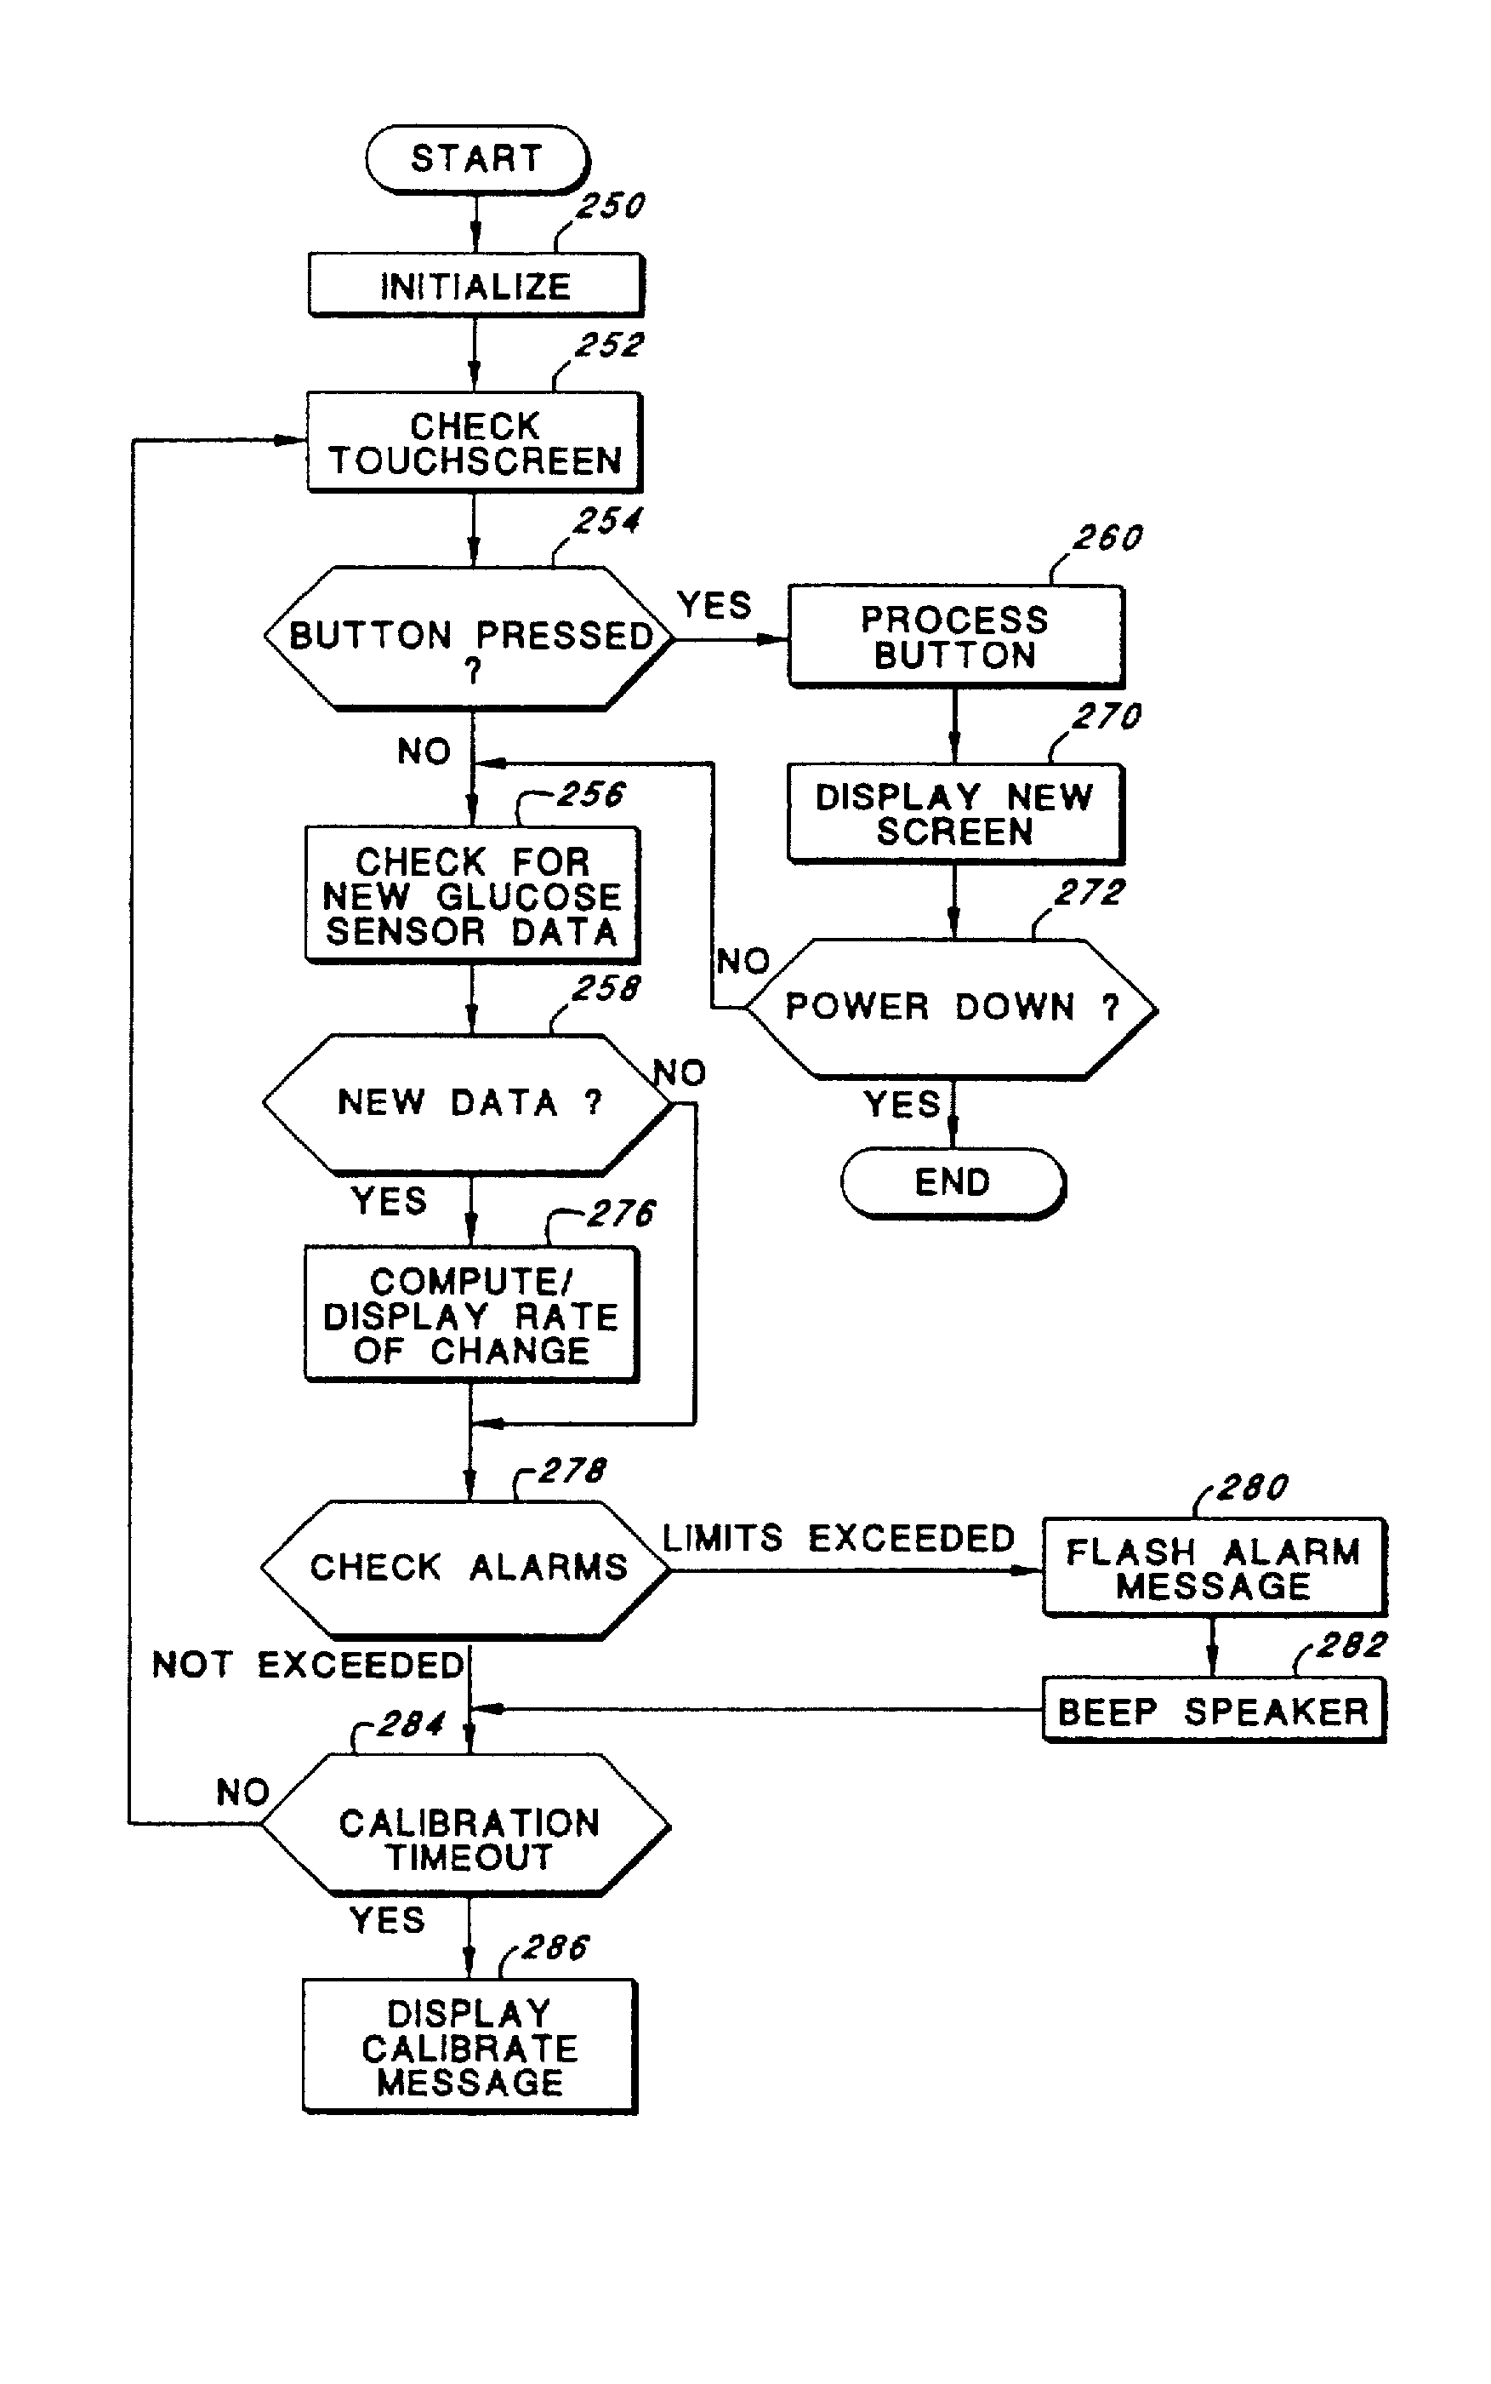
ALGORITHM
Fig 5. System Flowchart Ref[2]

Slide 10
TOOLS USED
The System is based on IOT.
It uses IOT to upload the patient data to the server and also to alert the relevant staff to the problem.
The entire system can be implemented with a simple code and will be highly efficient with very low error rates.

Slide 11
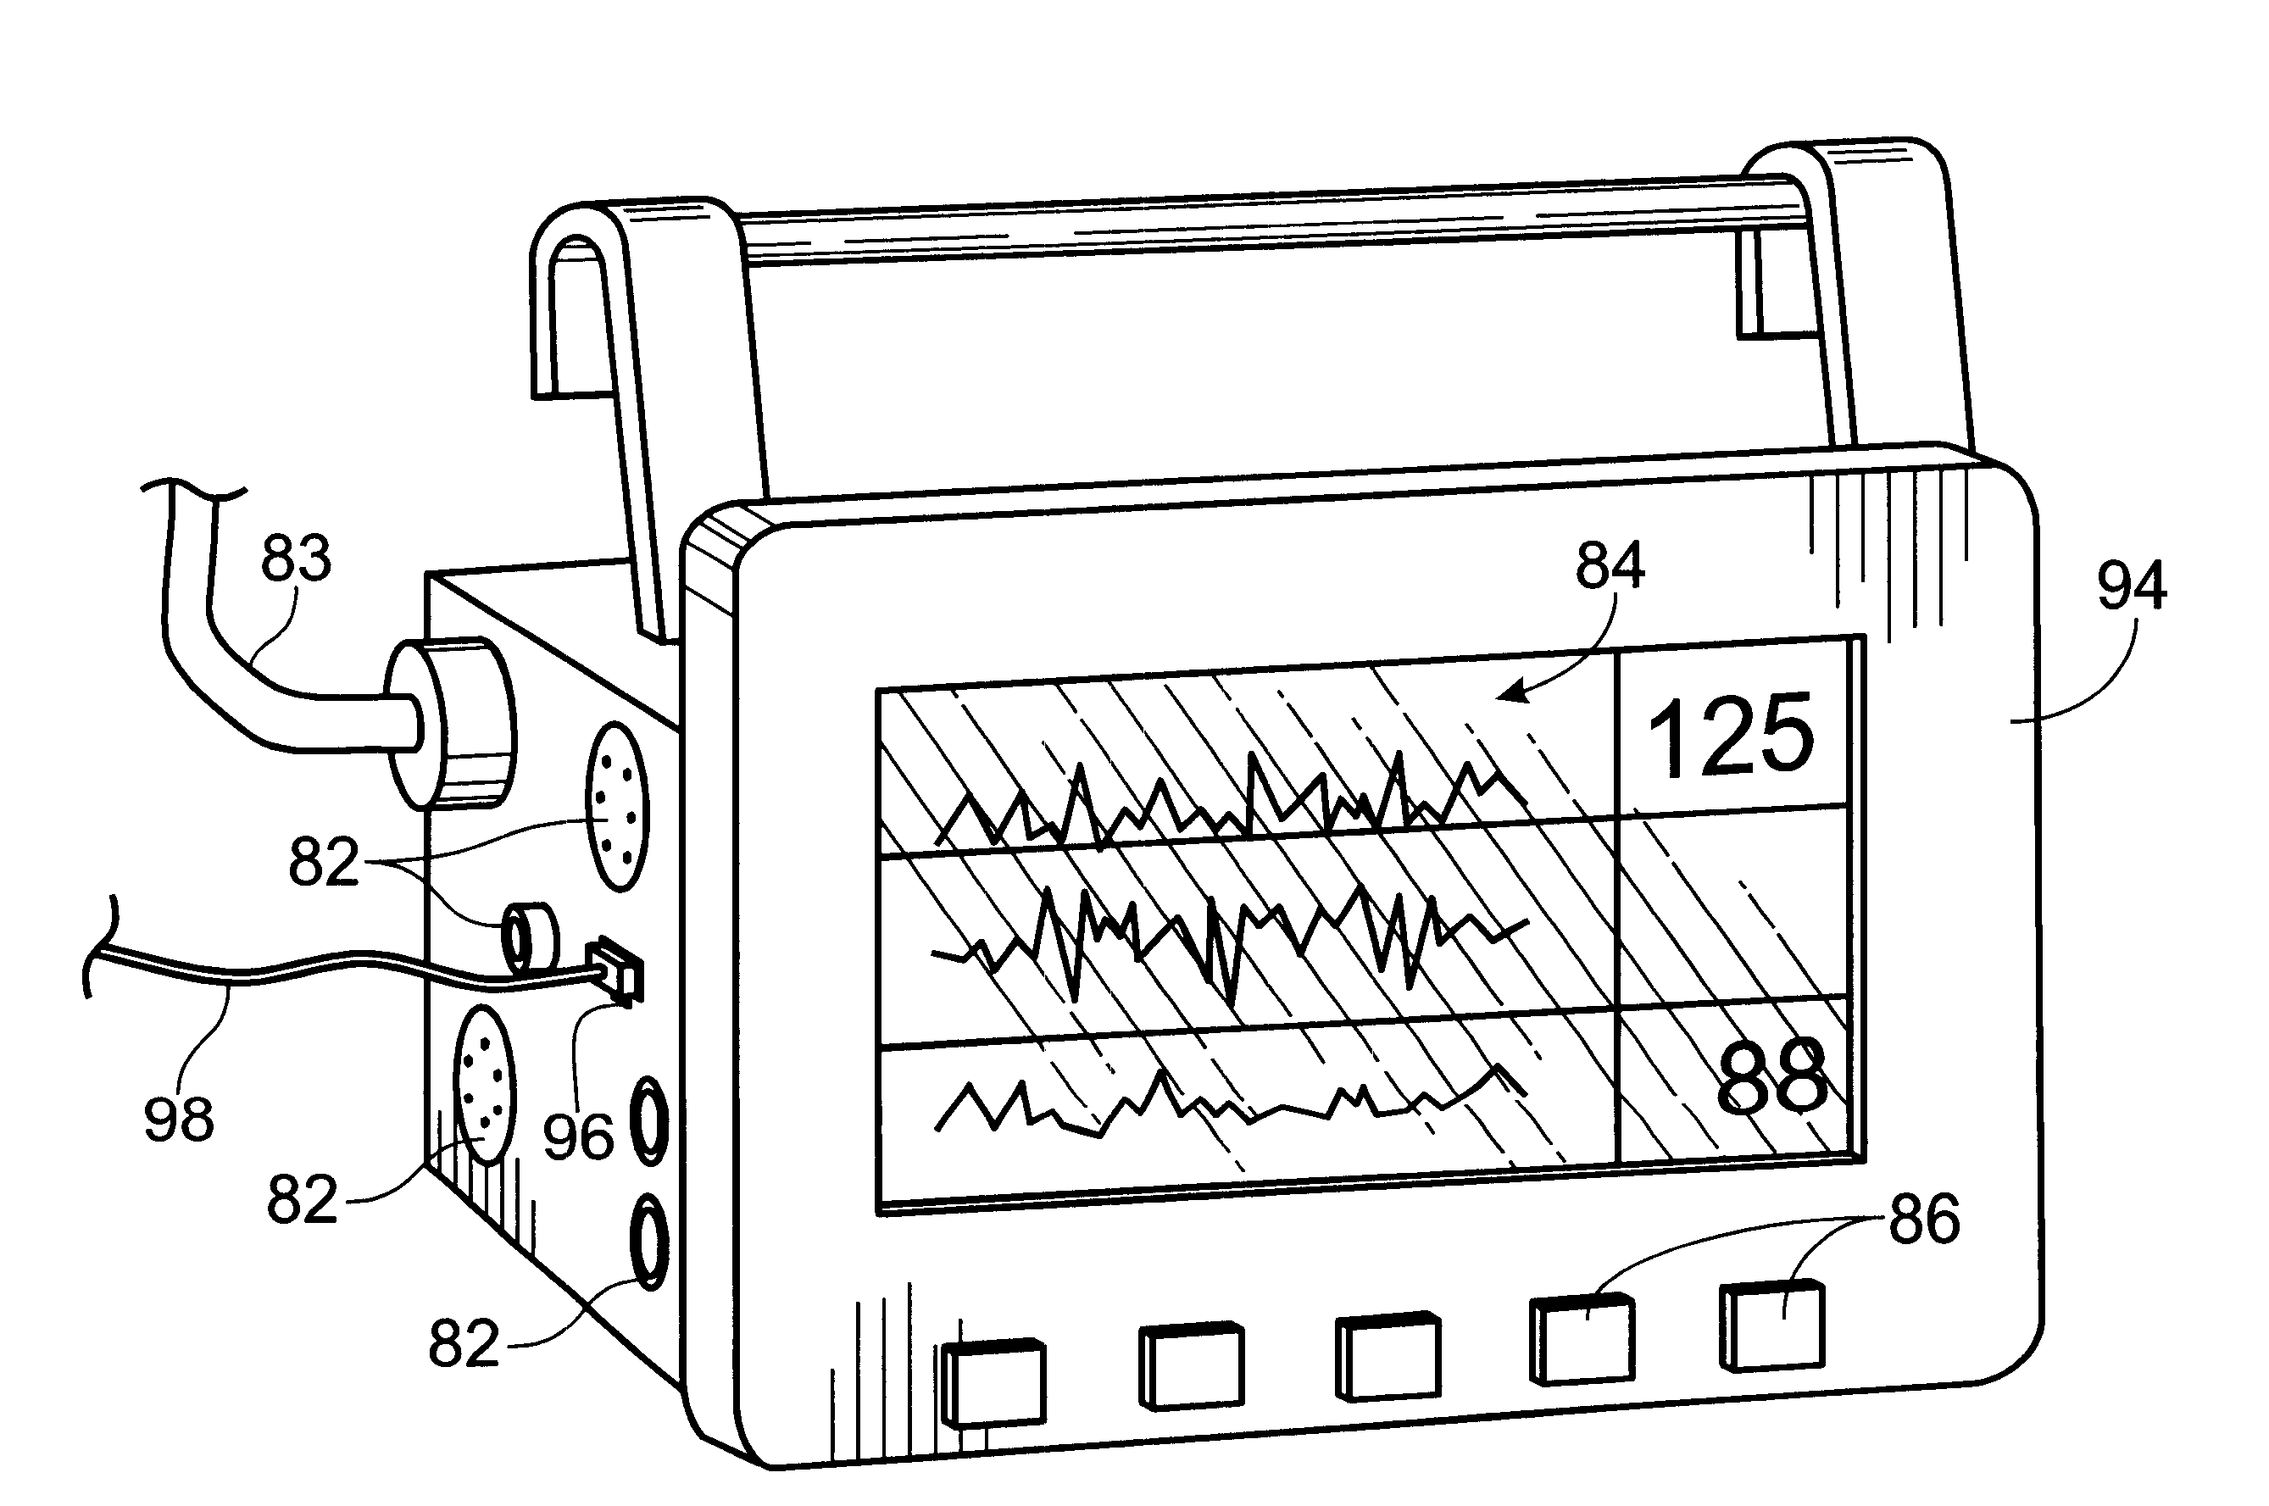
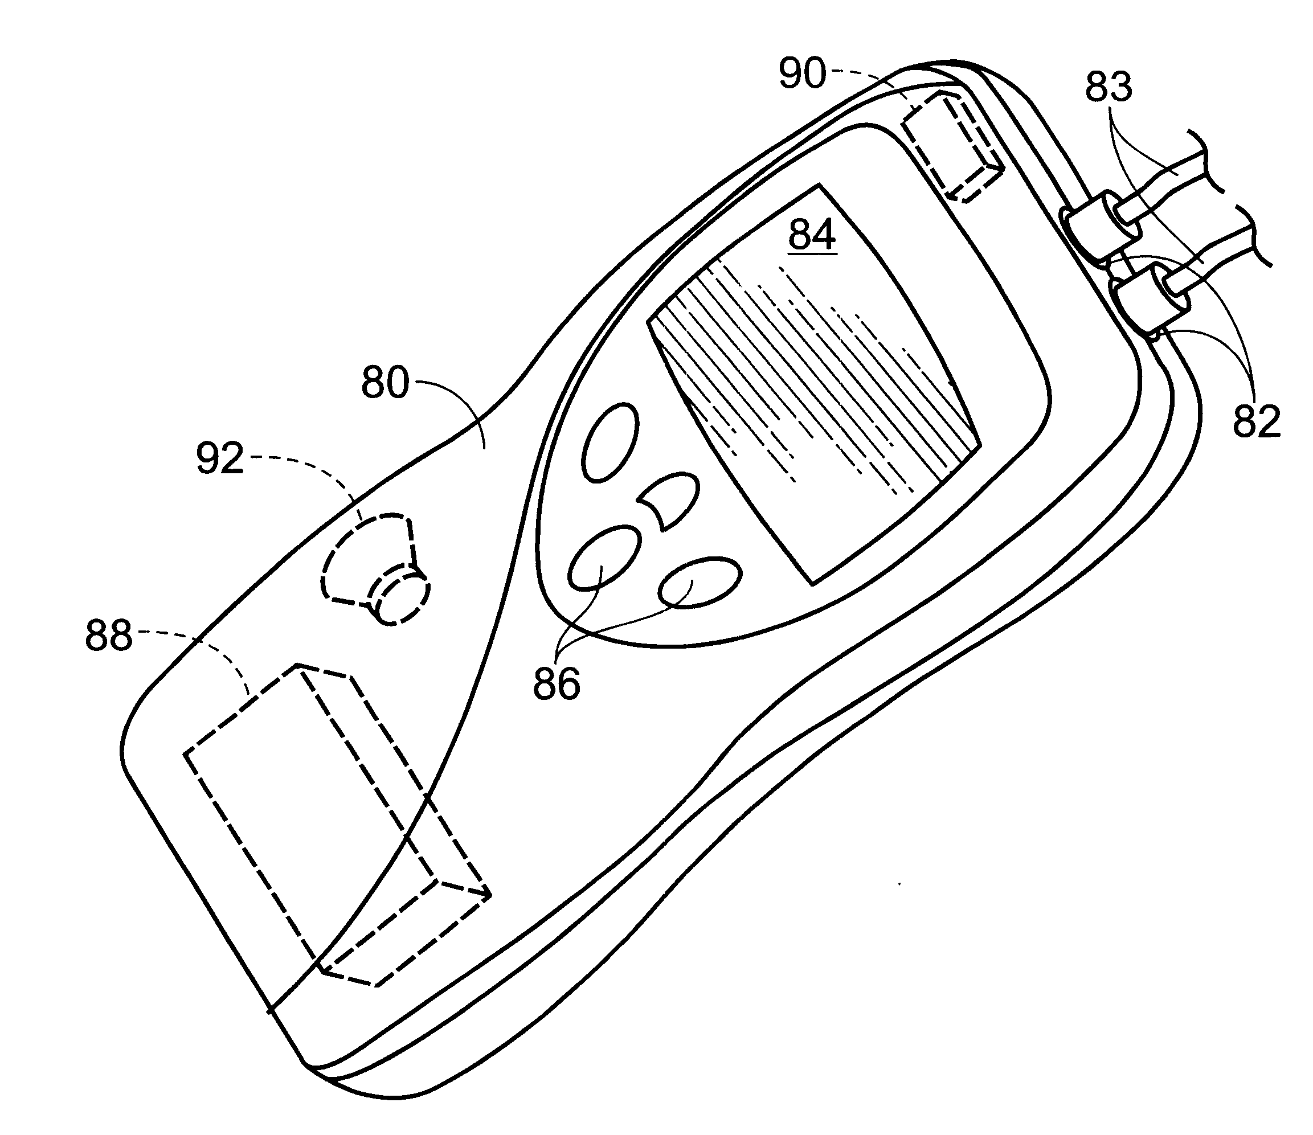
ERGONOMICS
9 cm
30 cm
20 cm
15 cm
6 cm
Fig 8. Monitor Screen Drawing Ref[2]
Fig 9. Handheld Device Ref[2]

Slide 12
ADVANTAGES
Saves time taken for the attention of the staff
All Patient Data can be stored on the server for future reference.
A historical timeline for patient health can be made aiding diagnosis

Slide 13
PRODUCT FEASABILITY
Patents on the proposed system exist. Eg,
U.S. Patent 5,791,344.
U.S. Patent 6,544,173.
U.S. Patent 3,972,320.

Slide 14
REFERENCES
Schulman, J.H., Lebel, R.J., Lucisano, J.Y., Mann, A.E., Rule III, O.R. and Whitmoyer, D.I., Mann Alfred E Foundation for Scientific Research, 1998. Patient monitoring system. U.S. Patent 5,791,344.
West, K.G., Colquitt, N.L., Weiner, H.S., Petersen, E.G. and Howell, W.H., Welch Allyn Protocol Inc, 2003. Patient monitoring system. U.S. Patent 6,544,173.
tentabs.in/products/aqua-8-multi-parameter-patient-monitor
tentabs.in/collections/hospital-equipment/products/contec-patient-monitor-cms-8000
tentabs.in/collections/hospital-equipment/products/aqua-12-monitor
Kalman, G.U., 1976. Patient monitoring system. U.S. Patent 3,972,320.

Slide 15

The End

